Slide 1

ggPMX Workshop
Irina Baltcheva, Bruno Bieth & Souvik Bhattacharya
March 2019

Slide 2

ggPMX Team
Bruno Bieth, Irina Baltcheva, Souvik Bhattacharya, Amine Gassem*, Christian Bartels, Ivan Demin, Thomas Dumortier, Matt Fidler, Inga Ludwig, Ines Paule
LT sponsor: Didier Renard
*R developer

Slide 3

Contribution to PMX community
An open-source Pharmacometrician’s workflow in R: from exploration (xGx) to model building (nlmixr) and diagnostics (ggPMX)
Notes:
ggPMX is part of a new workflow for PMX in R – fully initiated by Novartis

Slide 4

At the end of this training, you will be able to...
Start using ggPMX for your projects (Monolix or nlmixr)
Produce graphs ready-to-use in reports and submissions
Reduce time and effort spent in:
writing scripts for diagnostic plots
validating scripts

Slide 5
Agenda
Time | Topic
9 AM | Welcome and getting everyone started
9:15 AM | Lecture & Hands-On: Introduction to ggPMX – R package for Model Diagnostics Generation
10:30 AM | Coffee Break
10:45 AM | Hands-On
11:30 AM | END

Slide 6
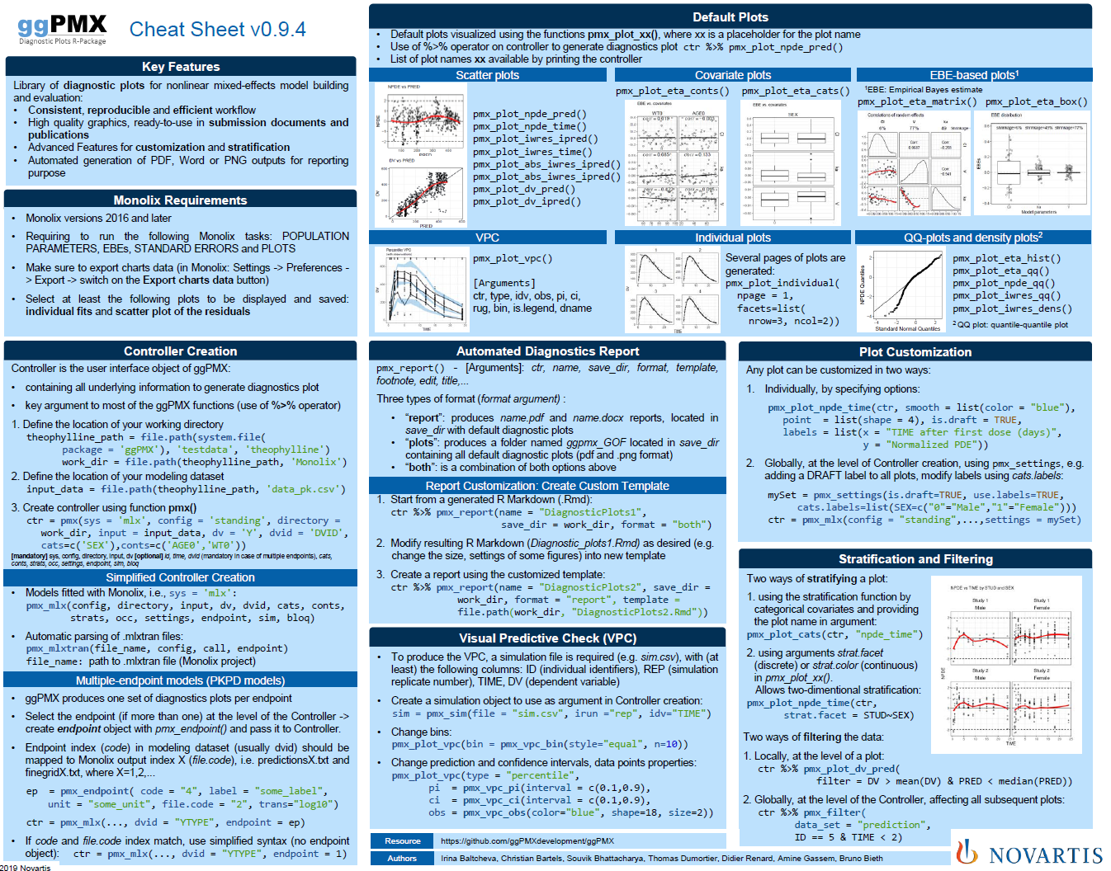
Cheat Sheet

Slide 7
Acronyms
BLQ | Below the limit of quantification
DV | Dependent variable
ETA | Inter-individual random effect
EBE | Empirical Bayes estimate
EPRED | Population prediction (expected)
HA | Health Authority
IIV | Inter-individual variability
IPRED | Individual prediction
NLME | Nonlinear mixed-effects (model)
NPD | Normalized prediction discrepancy
NPDE | Normalized prediction distribution error
PD | Pharmacodynamics
PK | Pharmacokinetics
VPC | Visual predictive check

Slide 8
Overview
Introduction
Monolix requirements (tasks to perform)
Installation
Architecture
Built-in example and default plots
Report generation
Advanced Controller creation
Single endpoint models
Multiple endpoint models
Models with covariates
VPC (Visual Predictive Checks)
Plots customization
Stratification, filtering and other features
How to provide feedback?

Slide 9
ggPMX - R package for model diagnostics
Why
No standard tools to support evaluation of nonlinear mixed effect models within the Pharmacometrics (PMX) across different softwares (Monolix, NONMEM, nlmxir)
What
Develop R package to provide a comprehensive and ‘modern’ set of tool to facilitate efficient diagnostics and reporting of models across different softwares
Who
Pharmacometrics Community
Goal
Improve consistency, efficiency and quality in internal usage of model diagnostics, translating into improved modeling productivity and quality
Where
Available on CRAN & GitHub

Slide 10

ggPMX is built upon the Novartis Pharmacometrics Internal Guidance on Good Practices for model building, evaluation and qualification
12+
R Library of diagnostic plots for nonlinear mixed-effects model building and evaluation:
Consistent, reproducible and efficient workflow
High quality graphics, ready-to-use in submission documents and publications
Advanced Features for customization and stratification
Automated generation of PDF, Word or PNG outputs for reporting purpose
Diagnostic Plots
2+
Types of Outputs (Monolix, nlmixR, NONMEM) handled by ggPMX

Slide 11
List of Diagnostic Plots
Section of modeling report | Description | Novartis | HA
Main body | Plot of normalized prediction distribution errors versus population predictions (NPD vs. EPRED) | ✔ | ✔
 | Plot of normalized prediction discrepancies versus time (NPD vs. TIME) | ✔ | ✔
 | Plot of individual weighted residuals versus individual predictions (IWRES vs. IPRED) | ✔ | ✔
 | Plot of individual weighted residuals versus time (IWRES vs. TIME) | ✔ | ✔
 | Visual predictive check (VPC) | ✔ | ✔
Appendix | Distribution and quantile-quantile plot of IWRES | ✔ | ✔
 | Distribution and correlation structure of estimated inter-individual random effects (ETA) | ✔ | ✔
 | Relationships between estimated inter-individual random effects (ETA) and covariates | ✔ | ✔
 | Plots of observations and model predictions per individual | ✔ | ✔
 | Plot of observations versus population predictions (DV vs. EPRED) |  | ✔
 | Plot of observations versus individual predictions (DV vs. IPRED) |  | ✔
 | Plot of absolute individual weighted residuals versus individual predictions (|IWRES| vs. IPRED) |  | ✔
Notes:
Section of modeling report: This suggests where to place the different plots, either in the main body or the appendix of the modeling report. It should not be seen as a strict rule; we want to emphasize content (i.e. the overall package of diagnostics that we consider essential for model evaluation) rather than where they should go in the report.

Slide 12
ggPMX: Intuitive & Fast (& Furious) Diagnostics report with two lines of code
# Controller Creation from Monolix project file
ctr <- pmx_mlxtran(file_name = mlxtran_path)
# Report Generation
ctr <- pmx_report()

Slide 13
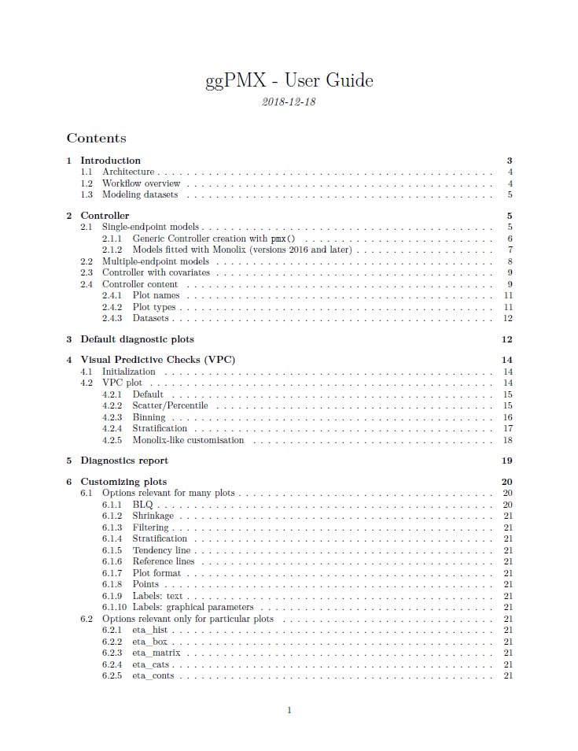
Documentation
Package available on CRAN
Documentation & Training Material on Github
https://github.com/ggPMXdevelopment/ggPMX
Cheat Sheet
Vignette (User Guide)

Slide 14
Overview
Introduction
Monolix requirements (tasks to perform)
Installation
Architecture
Built-in example and default plots
Report generation
Advanced Controller creation
Single endpoint models
Multiple endpoint models
Models with covariates
VPC (Visual Predictive Checks)
Plots customization
Stratification, filtering and other features
How to provide feedback?

Slide 15
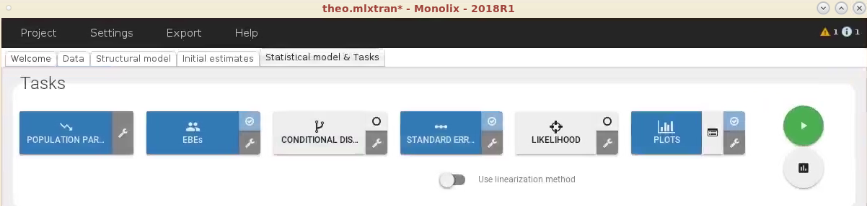
Monolix requirements to obtain all available diagnostic plots (1/3)
Monolix versions 2016 and later
Run at least the following Monolix tasks:
POPULATION PARAMETERS
EBEs
STANDARD ERRORS
PLOTS

Slide 16
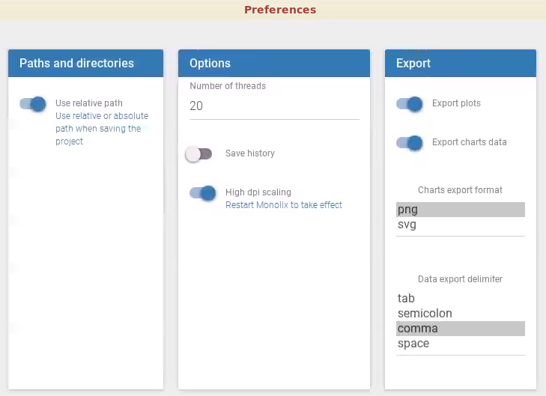
Monolix requirements to obtain all available diagnostic plots (2/3)
Make sure to export charts data
Settings -> Preferences -> Export -> switch on the Export charts data button

Slide 17
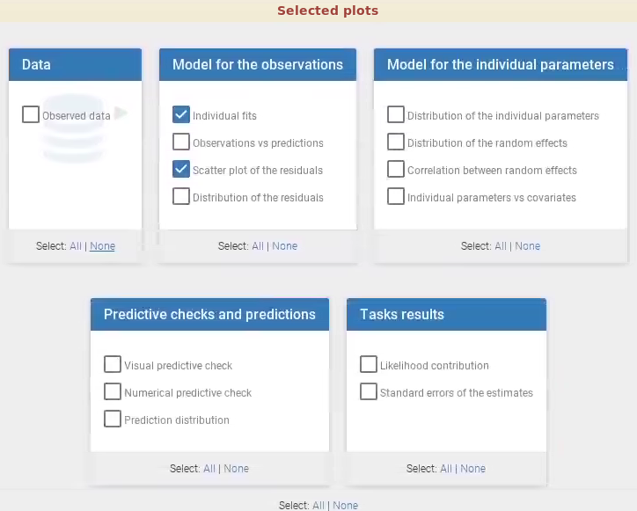
Monolix requirements to obtain all available diagnostic plots (3/3)
Select at least the following plots to be displayed and saved:
individual fits and
scatter plot of the residuals
If some Monolix output files are missing, ggPMX produces a warning and the corresponding plot won’t be available in the Controller.

Slide 18
Overview
Introduction
Monolix requirements (tasks to perform)
Installation
Architecture
Built-in example and default plots
Report generation
Advanced Controller creation
Single endpoint models
Multiple endpoint models
Models with covariates
VPC (Visual Predictive Checks)
Plots customization
Stratification, filtering and other features
How to provide feedback?

Slide 19
Installation
Open Rstudio and use R 3.6.1
In Rstudio command line (or in your R script), type:
library(ggPMX)
Verify that ggPMX has been included by typing:
sessionInfo()
Version should be 1.0

Slide 20
Overview
Introduction
Monolix requirements (tasks to perform)
Installation
Architecture
Built-in example and default plots
Report generation
Advanced Controller creation
Single endpoint models
Multiple endpoint models
Models with covariates
VPC (Visual Predictive Checks)
Plots customization
Stratification, filtering and other features
How to provide feedback?

Slide 21
Architecture
Object-oriented
Reader
Reads model outputs from modeling software
Restructures them into standard format for internal processing
Generator
Processes outputs from Reader by generating diagnostic plots
Controller
Serves as user interface to ggPMX object
The user will call Generator functions via wrapper functions in the Controller to produce either all the default plots or selected plots of interest
User can edit the configuration and customize plots
Reporter
Generates graphs and tables into an output file (Word or PDF) with annotations

Slide 22
Overview
Introduction
Monolix requirements (tasks to perform)
Installation
Architecture
Built-in example and default plots
Report generation
Advanced Controller creation
Single endpoint models
Multiple endpoint models
Models with covariates
VPC (Visual Predictive Checks)
Plots customization
Stratification, filtering and other features
How to provide feedback?

Slide 23
How to create a controller? Monolix Example: pmx_mlxtran()
pmx_mlxtran() parses the mlxtran file of a Monolix project to create the ggPMX controller
Only one mandatory argument: file_name: path to mlxtran file
To view the plots and other Controller fields, type:
# For example, use build-in mlxtran file in ggPMX
mlxtran_path <- file.path(system.file(package = "ggPMX"),"testdata","1_popPK_model", "project.mlxtran")
# Controller Creation
ctr <- pmx_mlxtran(file_name = mlxtran_path)
ctr

Slide 24
How to create a controller? nlmixr example: pmx_nlmxir()
pmx_nlmxir() parses the fit object from nlmixr model to create the ggPMX controller
Only one mandatory argument: fit: R-object fit created by nlmixr
More information, read nlmixr vignette:
# Assume that one.compartment (defined on backup slides) model is used to fit theophylline modeling dataset
fit <- nlmixr(one.compartment, theo_sd, est="saem", control=list(print=0))
# Controller Creation
ctr <- pmx_nlmixr(fit, vpc=FALSE)
vignette("ggPMX-nlmixr")

Slide 25
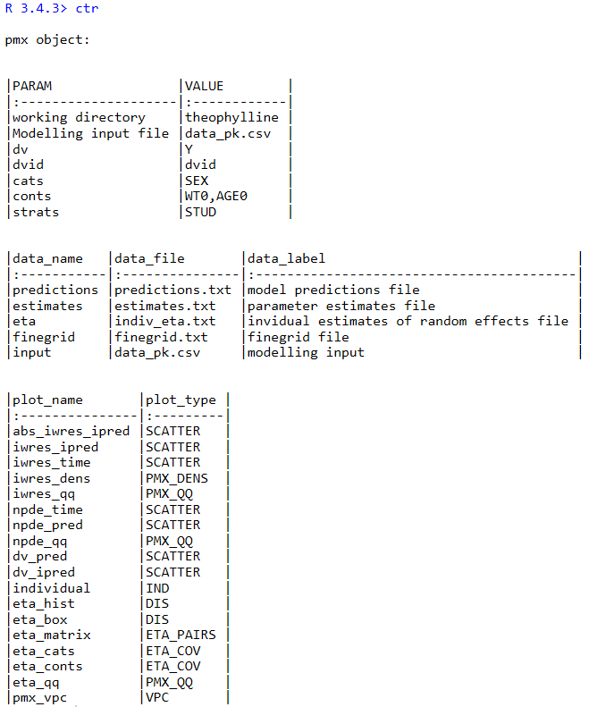
Controller content – Monolix 2018
Controller configuration
Monolix outputs
ggPMX datasets
Available plots
(command: pmx_plot_<plot_name>)

Slide 26
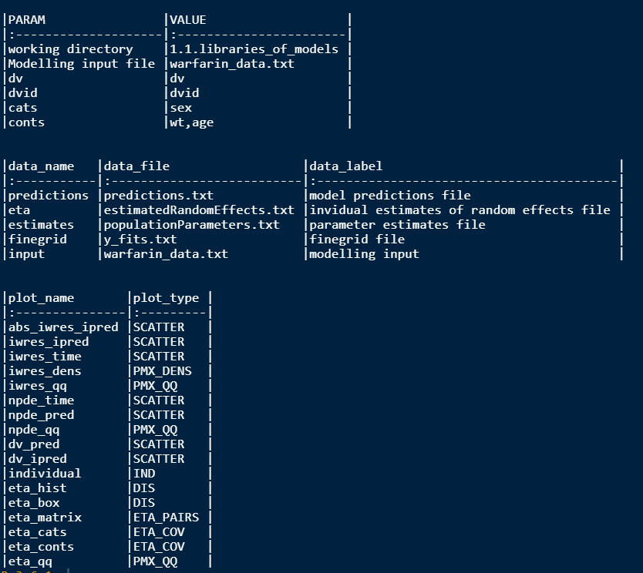
Controller content – Monolix 2019
Controller configuration
Monolix outputs
ggPMX datasets
Available plots
(command: pmx_plot_<plot_name>)

Slide 27
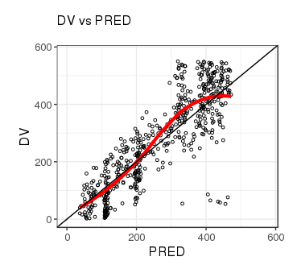
Default diagnostic plots
Plots visualized using the functions pmx_plot_xx(), where xx is a placeholder for the plot name. First argument is always the controller (use piping!)
List of plot names available by printing the controller or by calling the function plot_names()
Example:
ctr %>% pmx_plot_dv_pred()
ctr %>% pmx_plot_npde_time()
ctr %>% pmx_plot_eta_box()
ctr %>% pmx_plot_eta_matrix()
ctr %>% pmx_plot_individual()
ctr %>% pmx_plot_vpc()

Slide 28
How to create a controller? Error message when creating controller using pmx_mlxtran()?
Error preventing controller creation is probably due to unclear column naming in modeling dataset (dvid, id, time column naming) – only occurs with Monolix
To check the automatic assignment, use argument call=TRUE when using pmx_mlxtran()
Solution: specify explicitly the column mapping using pmx_mlx() (details on slides 35-40)
# # To check the automatic assignment without creating the controller:
ctr_check <- pmx_mlxtran(file_name = mlxtran_path, call=TRUE)
# DV and DVID column names in modeling dataset clearly specified:
ctr <- pmx_mlx( config = "standing",
directory = work_dir, # Directory Path to Monolix Outputs
input = input_data, # Modeling dataset name including path
dv = "Y", # DV column name in modeling dataset
dvid = "YTYPE", # DVID column name in modeling dataset
time = "TIM2") # TIME column name in modeling dataset

Slide 29
Overview
Introduction
Monolix requirements (tasks to perform)
Installation
Architecture
Built-in example and default plots
Report generation
Advanced Controller creation
Single endpoint models
Multiple endpoint models
Models with covariates
VPC (Visual Predictive Checks)
Plots customization
Stratification, filtering and other features
How to provide feedback?

Slide 30
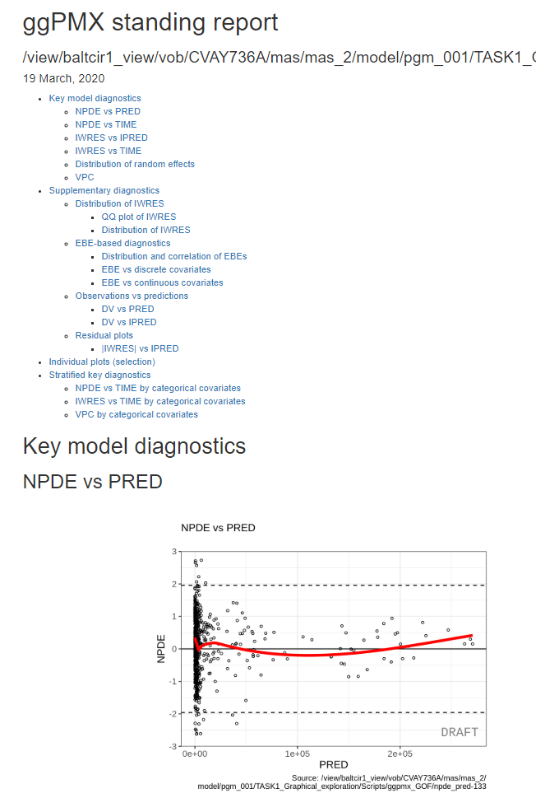
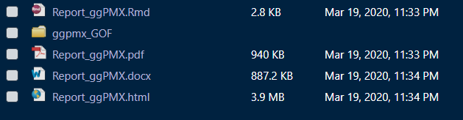
Diagnostics Report is an Rmarkdown file enabling easy customization
ctr %>% pmx_report( name = "Report_ggPMX“, save_dir = "work_dir",
format = "both", # report and plots
extension= "all") #.docx, .pdf, .html
Output of pmx_report():

Slide 31
Report generation: pmx_report()
Argument “extension” defines the format of the report (accepted values: “word”, “pdf”, “html”, “all”) – by default, Word document (only) is generated
Argument “format” can take 3 values:
“report”: produces name.docx (name.pdf if extension option includes pdf), located in save_dir with default diagnostic plots
“plots”: produces a folder named ggpmx_GOF located in save_dir that contains all default diagnostic plots, each in .png format (pdf format if extension option includes pdf). Plots are numerated with an unique identifier (ex: ebe_box-1.pdf)
“both”: is a combination of the two options above
Argument “save_dir” is the folder where you want the report
ctr %>% pmx_report( name = "Report_ggPMX“, # Report Filename
save_dir = "work_dir", # Directory Path to Report
format = "report", # Report Setting
extension= "pdf") # Report Format

Slide 32
Report Customization
The user can customize the default report by creating a “template”
To create a template:
Create a default report with the following command:
The resulting Rmarkdown file (gg_PMX_Report.Rmd) is the template you can customize
Modify ggPMX_Report.Rmd as desired (ex: change the size and settings of some figures) and save the modified Markdown file in another folder
Create a report using the new template by using argument “template”:
ctr %>% pmx_report(name=’ggPMX_Report’, save_dir = work_dir, format=’report’)
ctr %>% pmx_report( name = "Customized_ggPMX_Report",
save_dir = "work_dir",
format = "report ",
template = file.path(work_dir, "ggPMX_Report.Rmd"))

Slide 33
Overview
Introduction
Monolix requirements (tasks to perform)
Installation
Architecture
Built-in example and default plots
Report generation
Advanced Controller creation
Single endpoint models
Multiple endpoint models
Models with covariates
VPC (Visual Predictive Checks)
Plots customization
Stratification, filtering and other features
How to provide feedback?

Slide 34
Manual Controller creation
Parameter name | Meaning
sys | name of the software used for model fitting (“mlx”)
config | path to configuration file, name of configuration within the built-in list of configurations, or a configuration object
directory | path to directory containing fit results
input | path to modeling dataset (used for model fitting)
dv | name of column in modeling dataset that defines the dependent variable
id | name of column in modeling dataset that defines the subject identifier
time | name of column in modeling dataset that defines the independent (usually time) variable
dvid | name of column in modeling dataset that defines the identifier of the dependent variable (mandatory in case of multiple endpoint)
cats | vector of categorical covariates (as in modeling dataset)
conts | vector of categorical covariates (as in modeling dataset)
strats | vector of stratification variables (as in modeling dataset)
occ | name of dataset column for inter-occasion variability
settings | graphical settings shared by all plots
endpoint | defines the endpoint for which to display diagnostics
sim | user-provided simulations for VPC plot
bloq | defines settings of censored data
mandatory
character
optional
object

Slide 35
Models with covariates
ctr <- pmx_mlxtran( file_name = mlxtran_path
cats = c("SEX"), # Categorical Covariate
conts = c("WT0", "AGE0"), # Continuous Covariate
strats = c("STUD", "SEX")) # Categorical variables that can be # used for plot stratification,
# but are not used as covariates in # the model

Slide 36
Multiple endpoint models (1/4)
ggPMX produces one diagnostics report per endpoint
The endpoint is defined within the controller:
to filter the observations dataset
to keep only the values corresponding to the endpoint of interest
One report per endpoint, e.g. one pmx_report per controller
# Controller Creation for PD data (DVID==2)
ctrPD <- pmx_mlxtran(file_name = mlxtran_path, endpoint = 2)
ctrPD %>% pmx_report( name = "Report_ggPMX_PD“,# Report Filename
save_dir = "work_dir", # Directory Path to Report
format = "report", # Report Setting
extension= "pdf") # Report Format

Slide 37
Multiple endpoint models (2/4)
In Monolix, DVID values might not start from 1 leading to possible errors when creating controller per endpoint
Solution: use pmx_endpoint() to specify explicitly the DVID mapping with the numbering from Monolix outputs – see next 2 slides

Slide 38
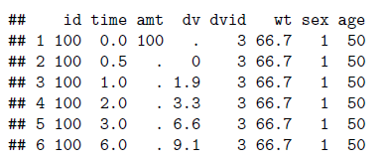
Multiple endpoints models (3/4) In case DVID does not start from 1
Built-in PKPD example:
The dvid column of the input dataset pk_pd.csv contains values=3 for PK (first endpoint) and dose and =4 for PD (second endpoint)
pkpd_path <- file.path(system.file(package = "ggPMX"),"testdata","pk_pd")
pkpd_work_dir <- file.path(pkpd_path, "RESULTS")
pkpd_input_file <- file.path(pkpd_path, "pk_pd.csv")

Slide 39
Multiple endpoints models (4/4) In case DVID does not start from 1
Monolix outputs numbering always starts from 1 despite DVID numbering starting from 3
predictions1.txt and finegrid1.txt for PK (DVID =3)
predictions2.txt and finegrid2.txt for PD (DVID =4)
Because of the numbering mismatch, use of pmx_endpoint() is required
pmx.ep <- pmx_endpoint( code = "4", # DVID mapping
file.code = "2 ") # numbering mapping
ctr <- pmx_mlx( config = "standing",
directory = pkpd_work_dir,
input = pkpd_input_file,
dv = "dv",
dvid = "dvid",
endpoint = pmx.ep) # Use of pmx_endpoint
## use predictions2.txt as model predictions file .
## use finegrid2.txt as finegrid file .

Slide 40
Overview
Introduction
Monolix requirements (tasks to perform)
Installation
Architecture
Built-in example and default plots
Report generation
Advanced Controller creation
Single endpoint models
Multiple endpoint models
Models with covariates
VPC (Visual Predictive Checks)
Plots customization
Stratification, filtering and other features
How to provide feedback?

Slide 41
VPC (1/6) – simulation dataset
User needs to provide a simulation file containing (at least) the following columns:
ID: individual identifiers
REP: simulation replicate number
TIME: time
DV: dependent variable
Use your preferred simulation software/package to create the simulation dataset (example code using simulix provided in back up)
Note: package classInt is used for binning

Slide 42
VPC (2/6) – Controller creation
To include the simulation dataset in ggPMX, create a “simulation object” using pmx_sim() and pass it as an argument to the controller.
theoph_path <- file.path(system.file(package = "ggPMX"), "testdata","theophylline")
WORK_DIR <- file.path(theoph_path, "Monolix")
input_file <- file.path(theoph_path, "data_pk.csv")
vpc_file <- file.path(theoph_path, "sim.csv")
ctr <- pmx_mlx(config = "standing",
directory = WORK_DIR,
input = input_file,
dv = "Y",
cats = c("SEX"),
conts = c("WT0", "AGE0"),
strats = "STUD",
sim = pmx_sim(file = vpc_file, irun ="rep", idv="TIME"))

Slide 43
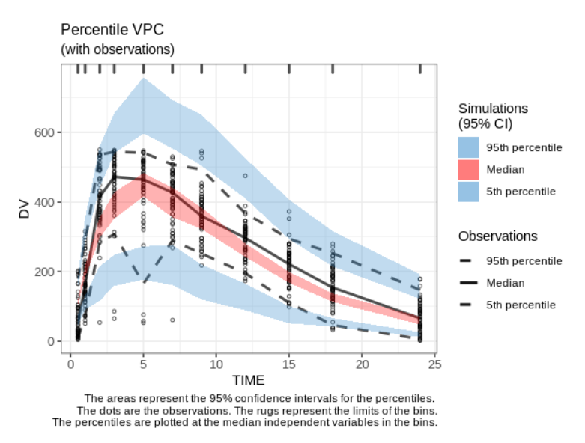
VPC (3/6) – the plot
ctr %>% pmx_plot_vpc()

Slide 44
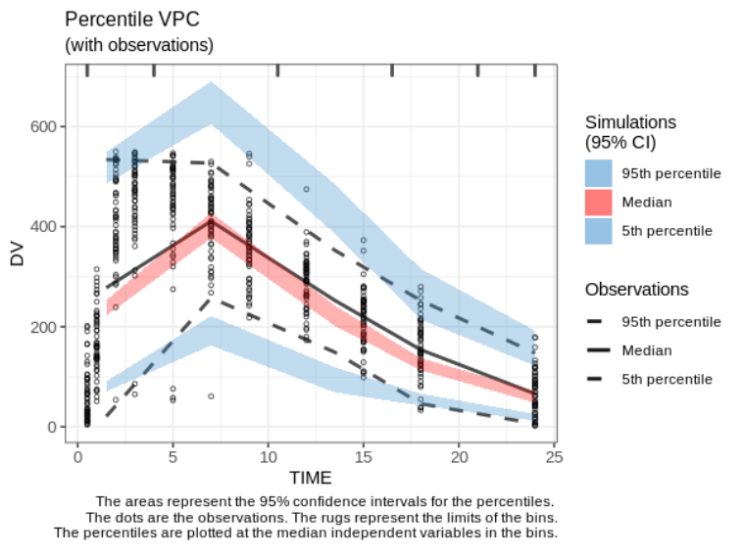
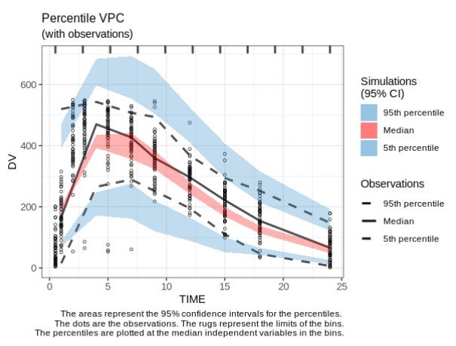
VPC (4/6) – change the bins
1.
2.
ctr %>% pmx_plot_vpc(bin=pmx_vpc_bin(style = "kmeans",n=5))
ctr %>% pmx_plot_vpc(bin=pmx_vpc_bin(style = “equal",n=10))
1.
2.

Slide 45
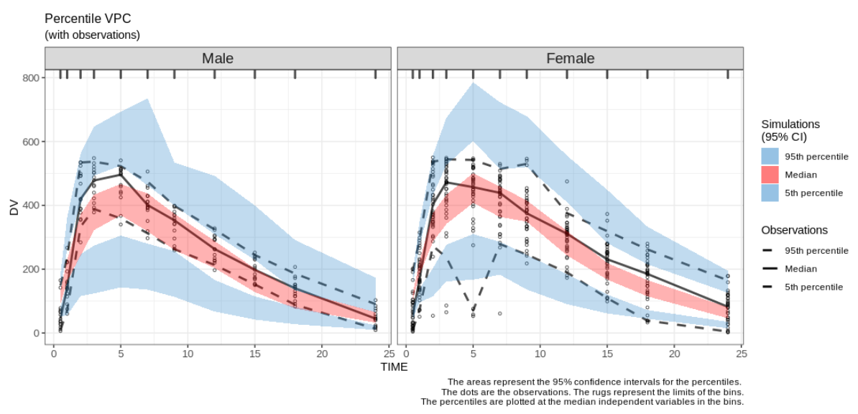
VPC (5/6) - stratification
ctr %>% pmx_plot_vpc(strat.facet="SEX", facets=list(ncol=2))

Slide 46
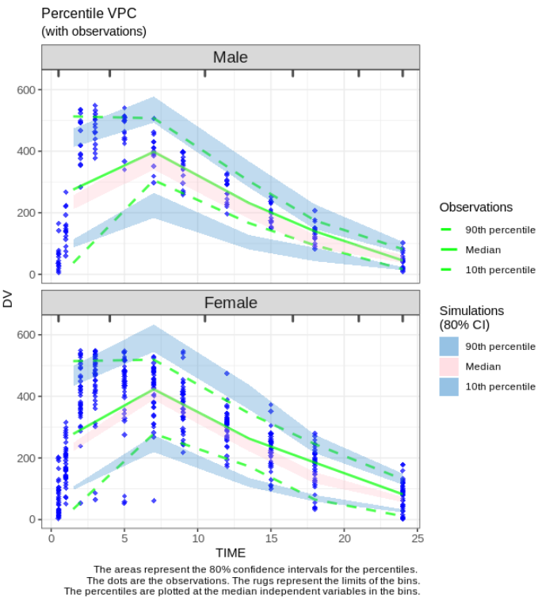
VPC (6/6) – changing uncertainty levels
ctr %>% pmx_plot_vpc(
strat.facet = "SEX",
facets = list(nrow=2),
type = "percentile",
is.draft = FALSE,
pi = pmx_vpc_pi(interval=c(0.1,0.9),
median = list(color="green"),
extreme = list(color="green")),
obs = pmx_vpc_obs(color="blue",
shape=18, size=2),
ci = pmx_vpc_ci(interval = c(0.1,0.9),
median = list(fill="pink")),
bin = pmx_vpc_bin("kmeans",n=5)
)

Slide 47
Overview
Introduction
Monolix requirements (tasks to perform)
Installation
Architecture
Built-in example and default plots
Report generation
Advanced Controller creation
Single endpoint models
Multiple endpoint models
Models with covariates
VPC (Visual Predictive Checks)
Plots customization
Stratification, filtering and other features
How to provide feedback?

Slide 48
Plots customization – two methods
On the fly (recommended), by specifying options in each function call
Globally, at the level of Controller creation, via settings argument

Slide 49
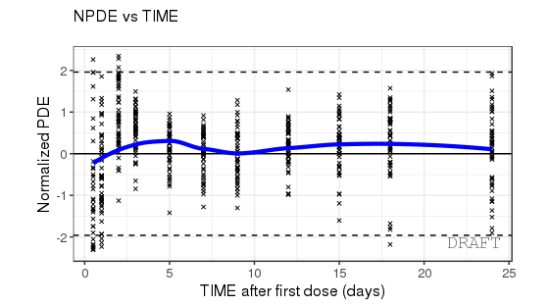
Plots customization – on the fly
ctr %>% pmx_plot_npde_time(
smooth = list(color = "blue"),
point = list(shape = 4),
is.draft = TRUE,
labels = list(x = "TIME after first dose (days)",
y = "Normalized PDE"))

Slide 50
Plots customization – globally
Create a “settings” object using pmx_settings(). This object is passed to pmx() as argument “settings”
Using such a syntax is useful when same setting is applied to all plots, e.g.:
Remove DRAFT label (printed by default)
Use meaningful labels, such as “Male” and “Female” instead of 0 or 1
Etc...
theoph_path <- file.path(system.file(package = "ggPMX"), "testdata", "theophylline")
WORK_DIR <- file.path(theoph_path, "Monolix")
input_file <- file.path(theoph_path, "data_pk.csv")
vpc_file <- file.path(theoph_path, "sim.csv")
my_settings = pmx_settings( use.labels = TRUE,
is.draft = FALSE,
cats.labels=list( SEX =c("0"="Male","1"="Female"),
STUD =c("1"="Study 1", "2"="Study 2")))
ctr <- pmx_mlx( config = "standing",
directory = WORK_DIR,
input = input_file,
dv = "Y",
cats = c("SEX"),
conts = c("WT0", "AGE0"),
strats = "STUD",
settings = my_settings,
sim = pmx_sim(file = vpc_file, irun ="rep", idv="TIME"))
Global settings

Slide 51
Overview
Introduction
Monolix requirements (tasks to perform)
Installation
Architecture
Built-in example and default plots
Report generation
Advanced Controller creation
Single endpoint models
Multiple endpoint models
Models with covariates
VPC (Visual Predictive Checks)
Plots customization
Stratification, filtering and other features
How to provide feedback?

Slide 52
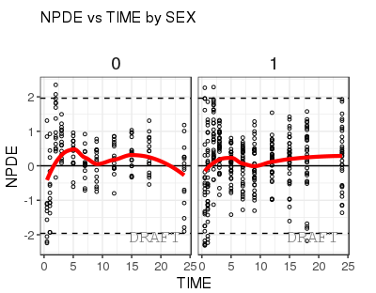
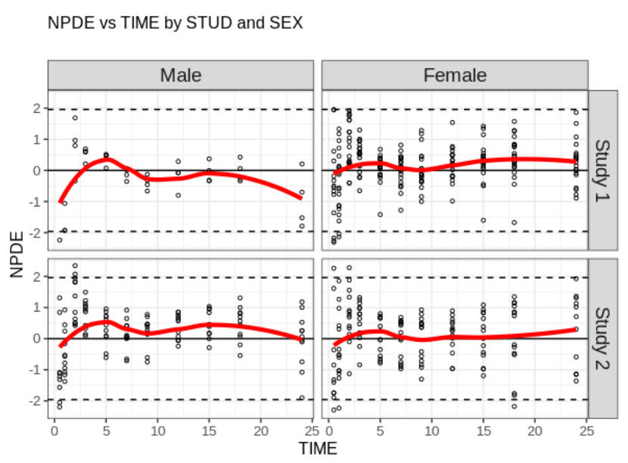
Stratification
Two ways of stratifying a plot:
1. using the stratification function by categorical covariates and providing the plot name in argument:
2. using arguments strat.facet (discrete) or strat.color (continuous) in pmx_plot_xxx(). Allows two-dimentional stratification:
pmx_plot_cats(ctr, "npde_time")
pmx_plot_npde_time(ctr,
strat.facet = STUD~SEX)

Slide 53
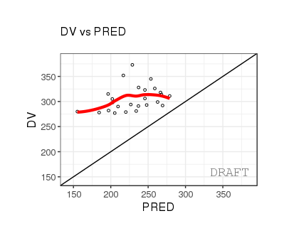
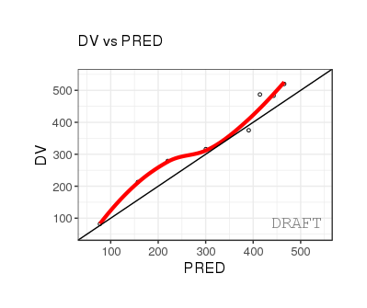
Filtering
Two ways of filtering the data:
Locally, at the level of a plot:
Globally, at the level of the Controller, affecting all subsequent plots:
ctr %>% pmx_plot_dv_pred(filter = DV > mean(DV) & PRED < median(PRED))
ctr %>% pmx_filter(data_set = "prediction",ID == 5 & TIME > 2)
ctr %>% pmx_plot_dv_pred

Slide 54
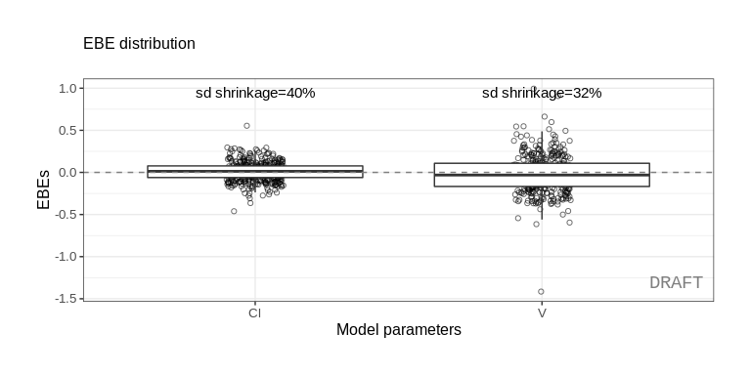
Filtering random effects
ctr %>% pmx_plot_eta_box( filter = EFFECT %in% c('Cl','V') )

Slide 55
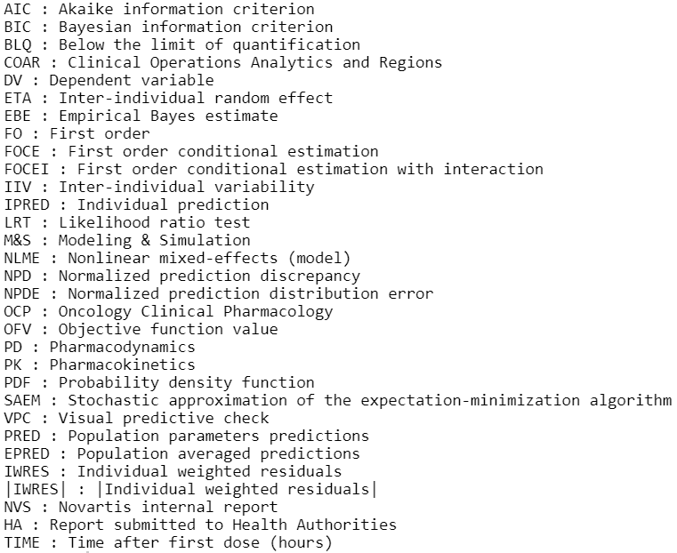
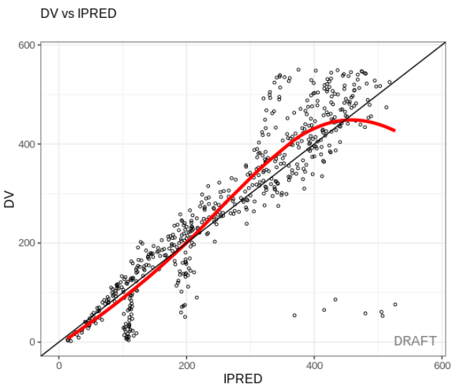
Labels of Axes and Facets Default setting
The “standing” configuration initializes all plots using abbreviations for axis labels.
Each abbreviation has its corresponding definition (full name). To get the list of abbreviations :
ctr %>% get.abbrev()
# By default, short names are used for axis labels
ctr %>% pmx_plot_dv_ipred()

Slide 56
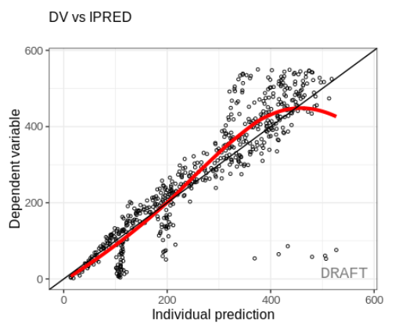
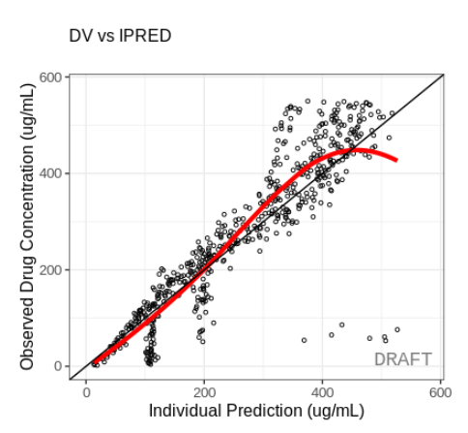
Modifying labels - locally
1. Using full names from the abbreviation table
# Using the default labels:
ctr %>% pmx_plot_dv_ipred( use.abbrev = TRUE )
2. Using customized labels (including units)
# Using your own labeling:
ctr %>% pmx_plot_dv_ipred(
labels = list(
x = 'Individual Prediction (ug/mL)',
y = 'Observed Drug Concentration (ug/mL)'))

Slide 57
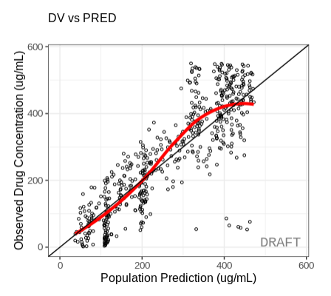
Modifying labels - globally
1. Using customized label across all plots
# Using customized labels for all plots by modifying controller
ctr %>% set_abbrev(
IPRED = 'Individual Prediction (ug/mL)',
PRED = 'Population Prediction (ug/mL)',
DV = 'Observed Drug Concentration (ug/mL)')
# Changes applied to all plots using DV or IPRED label
ctr %>% pmx_plot_dv_ipred( use.abbrev = TRUE )
ctr %>% pmx_plot_dv_pred( use.abbrev = TRUE )
2. Using full names when creating the controller for all plots
# Using long names labels for all plots by modifying controller
ctr <- pmx_mlxtran(
file_name = mlxtran_path,
settings = pmx_settings( use.abbrev = TRUE ))
# use.abbrev set to TRUE by default for all ggPMX plots
ctr %>% pmx_plot_dv_ipred()

Slide 58
Other available features
More features are available in the package (in back-up):
BLQ
Shrinkage
Controller creation for nlmixr models
For info on the above, see backup slides and/or read the vignette (go/ggPMX) and the help
vignette("ggPMX-guide")

Slide 59
Overview
Introduction
Monolix requirements (tasks to perform)
Installation
Architecture
Built-in example and default plots
Report generation
Advanced Controller creation
Single endpoint models
Multiple endpoint models
Models with covariates
VPC (Visual Predictive Checks)
Plots customization
Stratification, filtering and other features
How to provide feedback?

Slide 60
How to provide feedback?
If you find a bug or if you would like to suggest improvements, please submit a ticket on GitHub
https://github.com/ggPMXdevelopment/ggPMX

Slide 61
Missing Features
Prediction Interval for NPDE plot missing
IOV not fully tested
Possible bug when too many digits (after comma) used in TIME values (rounding performed by Monolix preventing reconciliation of modeling dataset and Monolix outputs)

Slide 63
Backup

Slide 64
Simulation code for VPC
## Library setting
library(dplyr)
library(mlxR)
setMlxLibraryPath("/CHBS/apps/Monolix/2018R1");
## Path and filename of the mlxtran project
myprojfilename <- '...../myprojfile.mlxtran'
## Path and filename of the to-be-created simulation file
mysimfilename <- '...../mysimfile.csv’
## NN - Create vpc file and store it
mysim <- simulx(project=myprojfilename,nrep=200)
## with simulx, ids are changed to a new ID, starting at 1. one should modify the simulated file to revert the original IDs:
simdata = mysim$y3
simdata <- simdata %>% left_join(., mysim$originalId) %>%
mutate(id = oriId) %>% select(-oriId, -newId)
write.csv(mysim$dv,file=mysimfilename,quote=F,row.names = F)
## Display the simulation file
## For each record in the input dataset (identified by id and time),
## there will be nrep (here, 200) simulations, identified by rep=1, 2, ..., nrep.
head(mysim)

Slide 65
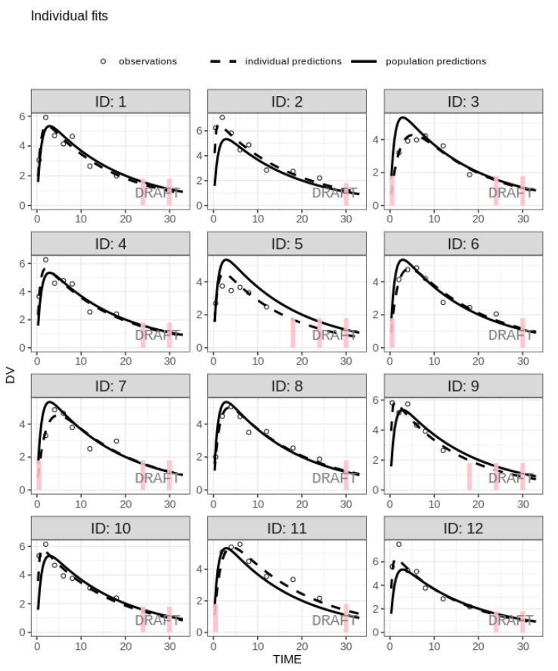
BLOQ
Create controller with BLOQ data (BLQ column in input dataset):
For more details, see BLOQ vignette:
ctr <- pmx_mlxtran(file_name=mlx_file, bloq = pmx_bloq(cens = “BLQ"))
ctr %>% pmx_plot_individual()

Slide 66
Shrinkage
The shrinkage is a computation within controller data. It might be used to annotate the plots. It can be generated directly from pmx_comp_shrink
ctr %>% pmx_comp_shrink
#> EFFECT OMEGA SHRINK POS
#> 1: Cl 0.22485 0.05793712 0.2934250
#> 2: V 0.03939 0.76978183 0.0057915
#> 3: ka 0.10024 0.49240546 0.0810850
User can remove shrinkage annotation using is.shrink option (TRUE in many pmx_plot_xx)
ctr %>% pmx_plot_eta_box( is.shrink = FALSE)

Slide 67
Controller creation - Single endpoint nlmixr (1/2)
library(ggPMX)
library(nlmixr)
one.compartment <- function() { ini({ tka <- 0.45 # Log Ka tcl <- 1 # Log Cl tv <- 3.45 # Log V eta.ka ~ 0.6 eta.cl ~ 0.3 eta.v ~ 0.1 add.sd <- 0.7 }) model({ ka <- exp(tka + eta.ka) cl <- exp(tcl + eta.cl) v <- exp(tv + eta.v) d/dt(depot) = -ka * depot d/dt(center) = ka * depot - cl / v * center cp = center / v cp ~ add(add.sd) }) }
fit <- nlmixr(one.compartment, theo_sd, est= "saem" ,control=list(print=0))
saveRDS(fit,"fit.rds")
ctr = pmx_nlmxir(fit, vpc= FALSE)
#Define the one compartmental model for nlmixr
#Use nlmixr to estimate the parameters of the one compartmental model
#Create the controller function

Slide 68
Controller creation - Single endpoint nlmixr (2/2)
fit <- readRDS("fit.rds")
print(fit)
fit %>% pmx_nlmixr(vpc = FALSE) ->. ctr
ctr %>% pmx_plot_dv_pred
#Read the fit function into the system
#The fit object is a nlmixr fit; You can read it into the nlmixr controller by:
#Obtain the diagnostic plots as before

Slide 69
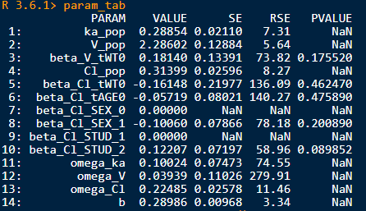
Table with parameter estimates
param_tab = ctr %>% get_data("estimates")

Slide 70
Old Slides

Slide 71
Residual-based diagnostics Normalized Prediction Discrepancies (NPD) plots - Direct evaluation of systematic deviations between model predictions and observations along a horizontal (zero) line
Section of modeling report | Description | Novartis | HA
Main body | Plot of normalized prediction distribution errors versus population predictions (NPD vs. EPRED) | ✔ | ✔
 | Plot of normalized prediction discrepancies versus time (NPD vs. TIME) | ✔ | ✔
 | Plot of individual weighted residuals versus individual predictions (IWRES vs. IPRED) | ✔ | ✔
 | Plot of individual weighted residuals versus time (IWRES vs. TIME) | ✔ | ✔
 | Visual predictive check (VPC) | ✔ | ✔
Appendix | Distribution and quantile-quantile plot of IWRES | ✔ | ✔
 | Distribution and correlation structure of estimated inter-individual random effects (ETA) | ✔ | ✔
 | Relationships between estimated inter-individual random effects (ETA) and covariates | ✔ | ✔
 | Plots of observations and model predictions per individual | ✔ | ✔
 | Plot of observations versus population predictions (DV vs. EPRED) |  | ✔
 | Plot of observations versus individual predictions (DV vs. IPRED) |  | ✔
 | Plot of absolute individual weighted residuals versus individual predictions (|IWRES| vs. IPRED) |  | ✔
Notes:
Residual plots provide a direct evaluation of systematic deviations between model predictions and observations along a horizontal (zero) line
NPD are plotted versus population predictions or versus time, which is a key independent variable in most population analyses.

Slide 72
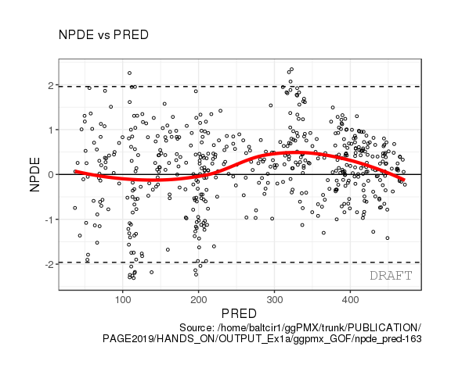
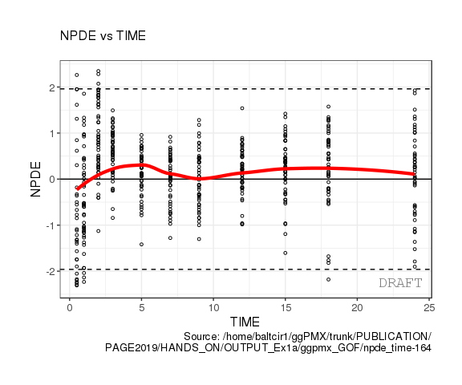
Residual-based diagnostics Normalized Prediction Discrepancies (NPD) plots - Direct evaluation of systematic deviations between model predictions and observations along a horizontal (zero) line

Slide 73
Residual-based diagnostics Individual Weighted Residual (IWRES)- inform about adequacy of individual predictions and correctness of the residual error model / check distributional assumptions
Section of modeling report | Description | Novartis | HA
Main body | Plot of normalized prediction distribution errors versus population predictions (NPD vs. EPRED) | ✔ | ✔
 | Plot of normalized prediction discrepancies versus time (NPD vs. TIME) | ✔ | ✔
 | Plot of individual weighted residuals versus individual predictions (IWRES vs. IPRED) | ✔ | ✔
 | Plot of individual weighted residuals versus time (IWRES vs. TIME) | ✔ | ✔
 | Visual predictive check (VPC) | ✔ | ✔
Appendix | Distribution and quantile-quantile plot of IWRES | ✔ | ✔
 | Distribution and correlation structure of estimated inter-individual random effects (ETA) | ✔ | ✔
 | Relationships between estimated inter-individual random effects (ETA) and covariates | ✔ | ✔
 | Plots of observations and model predictions per individual | ✔ | ✔
 | Plot of observations versus population predictions (DV vs. EPRED) |  | ✔
 | Plot of observations versus individual predictions (DV vs. IPRED) |  | ✔
 | Plot of absolute individual weighted residuals versus individual predictions (|IWRES| vs. IPRED) |  | ✔
Notes:
These plots inform about adequacy of individual predictions and correctness of the residual error model

Slide 74
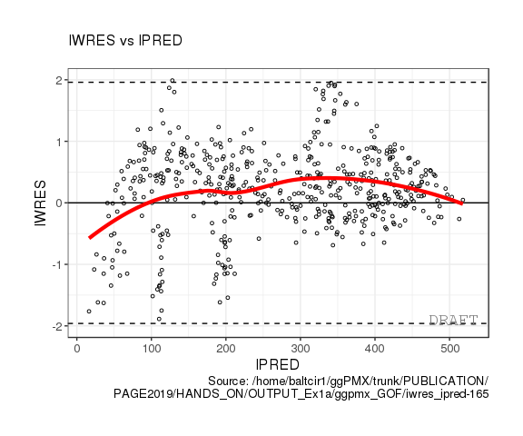
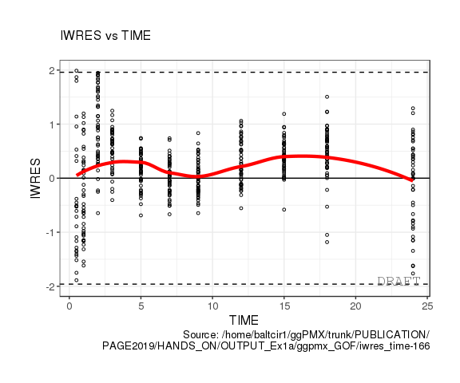
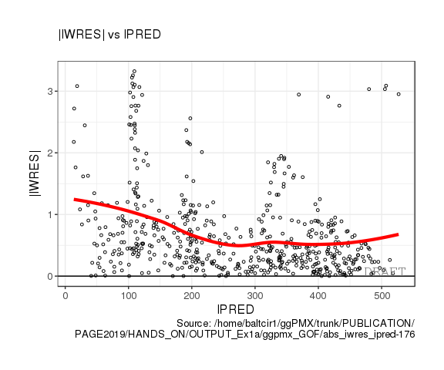
Residual-based diagnostics Individual Weighted Residual (IWRES)- inform about adequacy of individual predictions and correctness of the residual error model / check distributional assumptions
Notes:
When inspecting these plots, trends deviating from the zero line might indicate that the structural model is not appropriate or not flexible enough to describe some individual observations. The plot IWRES versus IPRED is also useful to assess if the residual error model is correct. Since IWRES should have constant unit variance under the correct model, any pattern in the spread of points would indicate a misspecification of the residual error model

Slide 75
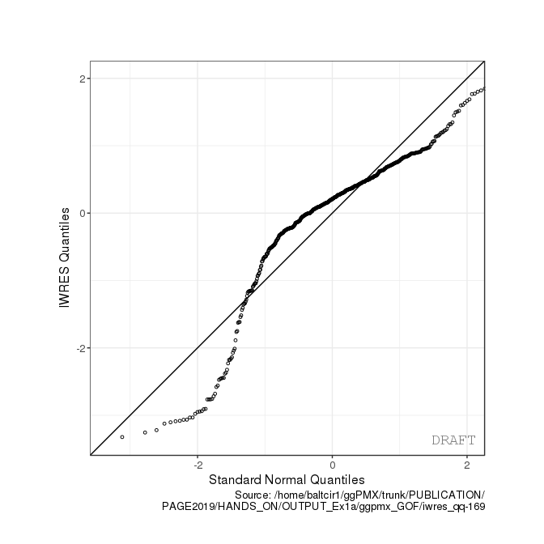
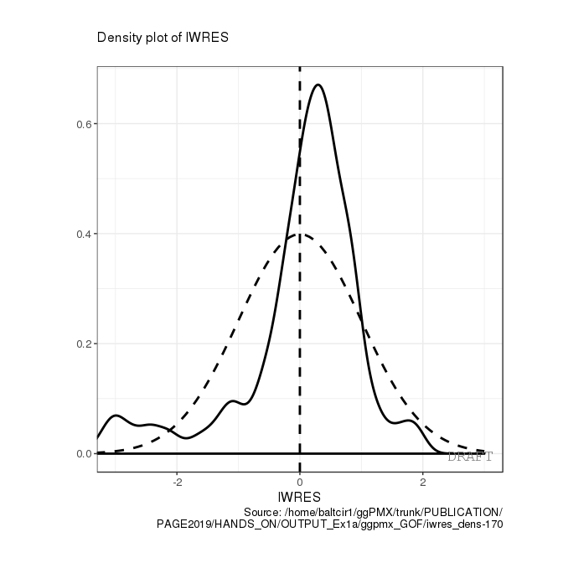
Residual-based diagnostics Individual Weighted Residual (IWRES)- inform about adequacy of individual predictions and correctness of the residual error model / check distributional assumptions
Notes:
Distribution: plot the smoothed density or histogram of IWRES and superimpose the density function of the standard normal distribution as reference.
The QQ plot displays the quantiles from the observed distribution of IWRES versus the theoretical quantiles of the standard normal distribution.
The identity line should be superimposed for reference. Ideally, the points should approximately lie on the straight line to conclude for a standard normal distribution

Slide 76
Residual-based diagnostics EBE-based Diagnostics - to assess the normality assumption and correlation structure of random effect / assess correctness of covariate relationship into model
Section of modeling report | Description | Novartis | HA
Main body | Plot of normalized prediction distribution errors versus population predictions (NPD vs. EPRED) | ✔ | ✔
 | Plot of normalized prediction discrepancies versus time (NPD vs. TIME) | ✔ | ✔
 | Plot of individual weighted residuals versus individual predictions (IWRES vs. IPRED) | ✔ | ✔
 | Plot of individual weighted residuals versus time (IWRES vs. TIME) | ✔ | ✔
 | Visual predictive check (VPC) | ✔ | ✔
Appendix | Distribution and quantile-quantile plot of IWRES | ✔ | ✔
 | Distribution and correlation structure of estimated inter-individual random effects (ETA) | ✔ | ✔
 | Relationships between estimated inter-individual random effects (ETA) and covariates | ✔ | ✔
 | Plots of observations and model predictions per individual | ✔ | ✔
 | Plot of observations versus population predictions (DV vs. EPRED) |  | ✔
 | Plot of observations versus individual predictions (DV vs. IPRED) |  | ✔
 | Plot of absolute individual weighted residuals versus individual predictions (|IWRES| vs. IPRED) |  | ✔
Notes:
Empirical Bayes estimates (EBE) of inter-individual random effects (ETA)

Slide 77
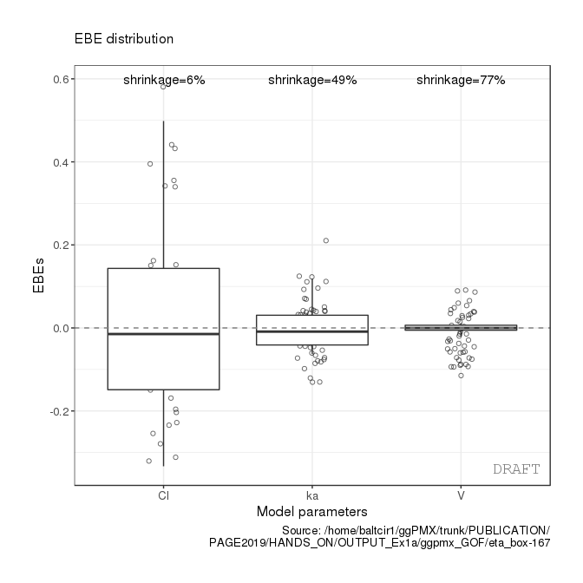
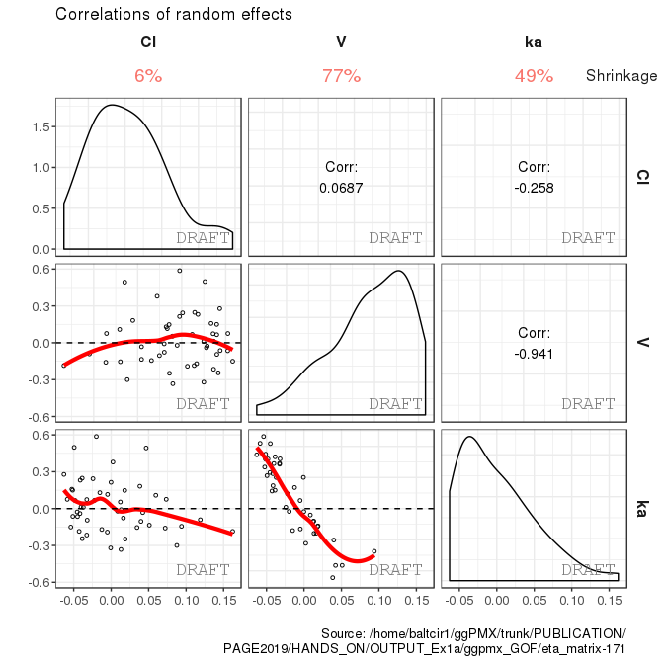
Residual-based diagnostics EBE-based Diagnostics - to assess the normality assumption and correlation structure of random effect / assess correctness of covariate relationship into model
Notes:
Distribution and correlation structure of random effect
These plots are useful to assess the normality assumption and correlation structure of ETA. This helps support the choice of covariance matrix ($Ω$) in the model. Use normalized ETAs in those plots, i.e. divide individual estimates (EBE) by the corresponding estimated standard deviations from $\hat{Ω}$.
Include a smooth line and report the value of correlation for pairs of ETA.
The value of η-shrinkage for each ETA should be displayed.

Slide 78
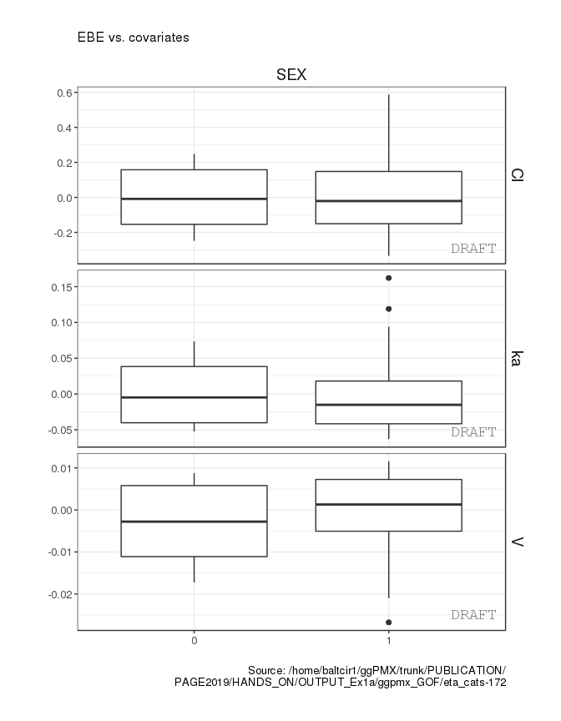
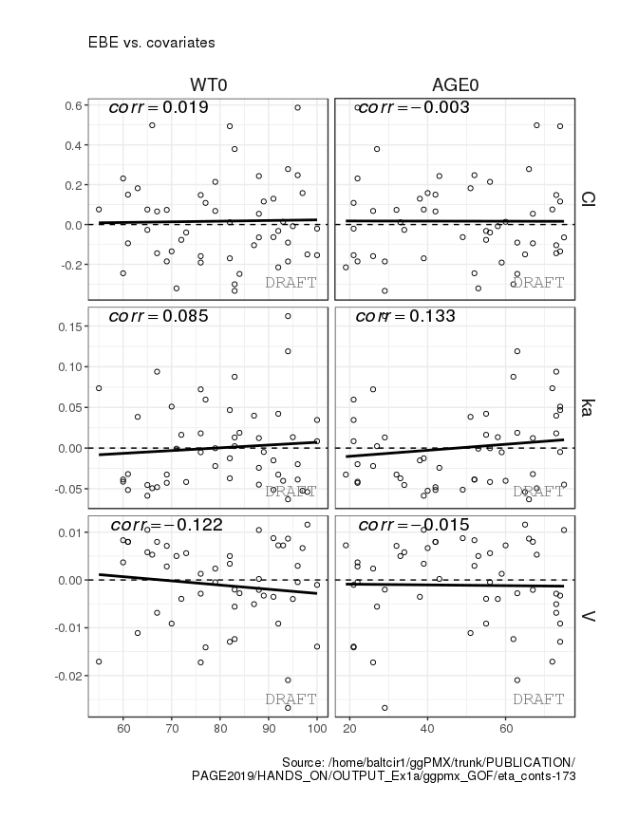
Residual-based diagnostics EBE-based Diagnostics - to assess the normality assumption and correlation structure of random effect / assess correctness of covariate relationship into model
Notes:
These plots are intended to show that covariate relationships have been appropriately taken into account in the model.
This should include relevant design features; in particular, it is always important to plot EBE versus dose (for example, this can be useful to detect nonlinearities in PK). Note that plots of ETA versus covariates should be produced both before and after inclusion of covariates in the final model)

Slide 79
Prediction-based diagnostics Individual Fits – Quick glance at performance of the model to describe data
Section of modeling report | Description | Novartis | HA
Main body | Plot of normalized prediction distribution errors versus population predictions (NPD vs. EPRED) | ✔ | ✔
 | Plot of normalized prediction discrepancies versus time (NPD vs. TIME) | ✔ | ✔
 | Plot of individual weighted residuals versus individual predictions (IWRES vs. IPRED) | ✔ | ✔
 | Plot of individual weighted residuals versus time (IWRES vs. TIME) | ✔ | ✔
 | Visual predictive check (VPC) | ✔ | ✔
Appendix | Distribution and quantile-quantile plot of IWRES | ✔ | ✔
 | Distribution and correlation structure of estimated inter-individual random effects (ETA) | ✔ | ✔
 | Relationships between estimated inter-individual random effects (ETA) and covariates | ✔ | ✔
 | Plots of observations and model predictions per individual | ✔ | ✔
 | Plot of observations versus population predictions (DV vs. EPRED) |  | ✔
 | Plot of observations versus individual predictions (DV vs. IPRED) |  | ✔
 | Plot of absolute individual weighted residuals versus individual predictions (|IWRES| vs. IPRED) |  | ✔
Notes:
Plots of individual fits are convenient to have a quick glance at the performance of a model to describe individual data.

Slide 80
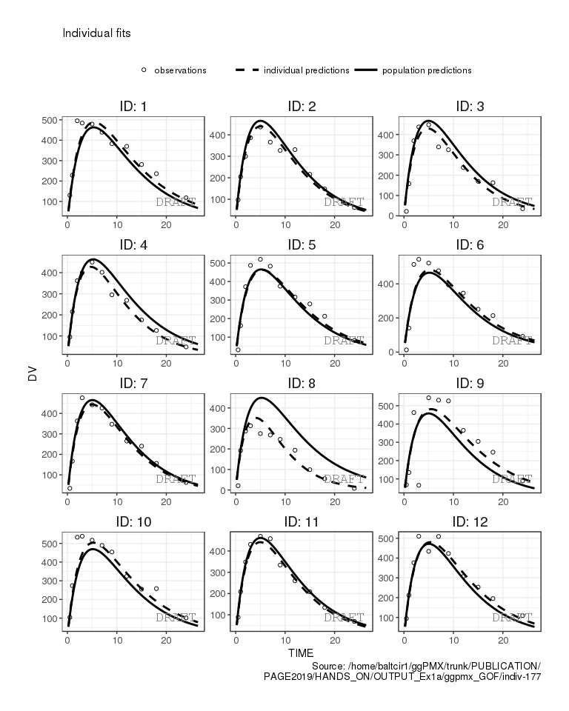
Prediction-based diagnostics Individual Fits – Quick glance at performance of the model to describe data
Notes:
In such a display, individuals are shown in separate panels. Within each panel, observations are represented as symbols, while population and individual predictions are superimposed as solid lines

Slide 81
Prediction-based diagnostics Observations versus predictions
Section of modeling report | Description | Novartis | HA
Main body | Plot of normalized prediction distribution errors versus population predictions (NPD vs. EPRED) | ✔ | ✔
 | Plot of normalized prediction discrepancies versus time (NPD vs. TIME) | ✔ | ✔
 | Plot of individual weighted residuals versus individual predictions (IWRES vs. IPRED) | ✔ | ✔
 | Plot of individual weighted residuals versus time (IWRES vs. TIME) | ✔ | ✔
 | Visual predictive check (VPC) | ✔ | ✔
Appendix | Distribution and quantile-quantile plot of IWRES | ✔ | ✔
 | Distribution and correlation structure of estimated inter-individual random effects (ETA) | ✔ | ✔
 | Relationships between estimated inter-individual random effects (ETA) and covariates | ✔ | ✔
 | Plots of observations and model predictions per individual | ✔ | ✔
 | Plot of observations versus population predictions (DV vs. EPRED) |  | ✔
 | Plot of observations versus individual predictions (DV vs. IPRED) |  | ✔
 | Plot of absolute individual weighted residuals versus individual predictions (|IWRES| vs. IPRED) |  | ✔
Notes:
Plots of observations versus model predictions are commonly used within the Pharmacometrics community.
However, their interpretation may be confounded by different factors and spurious trends can appear independently of model misspecification.
Also, for diagnostic purpose such plots do not provide extra information beyond residual-based diagnostics
We therefore do not recommend them in the package of basic diagnostic tools.
It should be acknowledged that such plots can nevertheless be useful, e.g. to communicate how the model is able to describe the observed data.
They may also be expected by some Health Authorities or journal reviewers.
Thus, in practice we recommend to include such graphs in the appendix of the Modeling Report

Slide 82
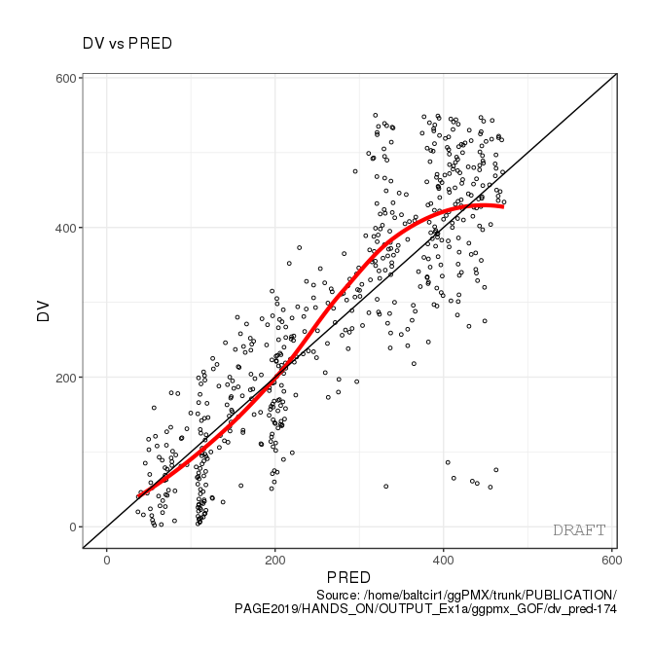
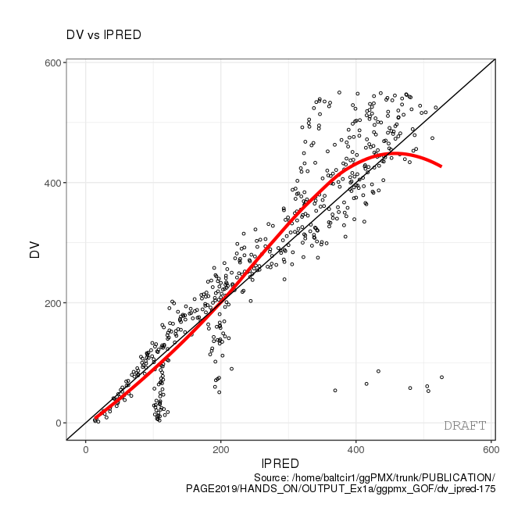
Prediction-based diagnostics Observations versus predictions– Communicate how the model can describe the observed data
Notes:
However, their interpretation may be confounded by different factors and spurious trends can appear independently of model misspecification.
Also, for diagnostic purpose such plots do not provide extra information beyond residual-based diagnostics
We therefore do not recommend them in the package of basic diagnostic tools.
It should be acknowledged that such plots can nevertheless be useful, e.g. to communicate how the model is able to describe the observed data.
They may also be expected by some Health Authorities or journal reviewers.
Thus, in practice we recommend to include such graphs in the appendix of the Modeling Report

Slide 83
Simulation-based diagnostics Visual Predictive Check (VPC) – Inform about appropriateness of the structural model and the random-effects structure
Section of modeling report | Description | Novartis | HA
Main body | Plot of normalized prediction distribution errors versus population predictions (NPD vs. EPRED) | ✔ | ✔
 | Plot of normalized prediction discrepancies versus time (NPD vs. TIME) | ✔ | ✔
 | Plot of individual weighted residuals versus individual predictions (IWRES vs. IPRED) | ✔ | ✔
 | Plot of individual weighted residuals versus time (IWRES vs. TIME) | ✔ | ✔
 | Visual predictive check (VPC) | ✔ | ✔
Appendix | Distribution and quantile-quantile plot of IWRES | ✔ | ✔
 | Distribution and correlation structure of estimated inter-individual random effects (ETA) | ✔ | ✔
 | Relationships between estimated inter-individual random effects (ETA) and covariates | ✔ | ✔
 | Plots of observations and model predictions per individual | ✔ | ✔
 | Plot of observations versus population predictions (DV vs. EPRED) |  | ✔
 | Plot of observations versus individual predictions (DV vs. IPRED) |  | ✔
 | Plot of absolute individual weighted residuals versus individual predictions (|IWRES| vs. IPRED) |  | ✔
Notes:
This plot compares the observations with their theoretical distribution under the estimated model.

Slide 84
Simulation-based diagnostics Visual Predictive Check (VPC) – Inform about appropriateness of the structural model and the random-effects structure
Notes:
If the model adequately describes the data, the observed percentiles should fall within the confidence intervals generated by simulations.
However, we do not recommend using the VPC in a more formal testing framework, e.g. by counting the number of points falling outside the confidence intervals as would be done with a numerical predictive check (not discussed here).
Because the VPC focuses on central tendency and spread in the data, it is helpful to inform about the appropriateness of the structural model and the random-effects structure.
It is also useful to contrast model fit with new data

Slide 85
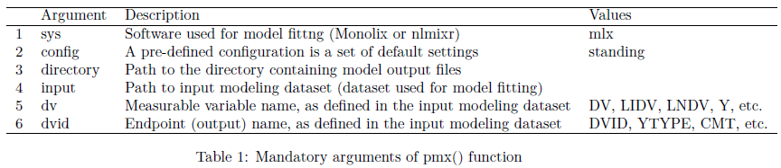
Manual Controller creation Monolix
The function pmx() is the generic function for creating a Controller.
theophylline_path = file.path(system.file(package = "ggPMX"), "testdata", "theophylline")
work_dir = file.path(theophylline_path, "Monolix")
input_data = file.path(theophylline_path, "data_pk.csv")
ctr = pmx(sys = "mlx", config = "standing",
directory = work_dir, input = input_data,
dv = "Y", dvid = "DVID", id= "ID", time = "TIME")

Slide 86
Simple built-in example to explore the package: theophylline
PK model of theophylline is included in the package for demo purpose
To load the example, type:
ctr = theophylline()
This will create a Controller called “ctr” (more explanations – slide 46)
To view the plots and other Controller fields, type:
ctr

Slide 87
Models fitted with Monolix (versions 2016 and later)
Simplified controller creation: pmx_mlx() is a wrapper function for pmx() with sys = “mlx”.
Further simplification: pmx_mlxtran() parses the mlxtran file of a Monolix project and assigns automatically the fields. Only one mandatory argument: file_name, the path to the mlxtran file. To check the automatic assignment, use argument call=TRUE
ctr <- pmx_mlx( config = "standing",
directory = work_dir,
input = input_data,
dv = "Y",
dvid = "DVID")
mlxtran_path <- file.path(system.file(package = "ggPMX"),
"testdata", "1_popPK_model", "project.mlxtran")
ctr <- pmx_mlxtran(file_name = mlxtran_path)
# To check the automatic assignment without creating the controller:
ctr_check <- pmx_mlxtran(file_name = mlxtran_path, call=TRUE)

Slide 88
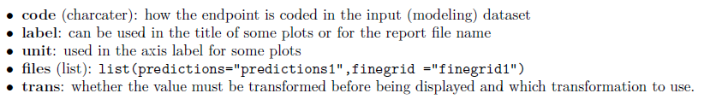
Multiple endpoint models (1/4)
ggPMX produces one diagnostics report per endpoint.
The endpoint is defined within the Controller:
to filter the observations dataset
to keep only the values corresponding to the endpoint of interest
The function pmx_endpoint() creates an “endpoint” object having the following attributes:

Slide 89
Multiple endpoints models (2/4)
Built-in PKPD example:
The dvid column of the input dataset pk_pd.csv contains values=3 for PK (first endpoint) and dose and =4 for PD (second endpoint).
pkpd_path <- file.path(system.file(package = "ggPMX"),"testdata","pk_pd")
pkpd_work_dir <- file.path(pkpd_path, "RESULTS")
pkpd_input_file <- file.path(pkpd_path, "pk_pd.csv")

Slide 90
Multiple endpoints models (3/4)
Monolix2016 outputs are found in folder RESULTS/ which contains
predictions1.txt and finegrid1.txt for PK
predictions2.txt and finegrid2.txt for PD
ep <- pmx_endpoint( code = "4",
label = "some_label",
unit = "some_unit",
file.code = "2", # will use predictions2.txt and finegrig2.txt
trans = "log10")
ctr <- pmx_mlx( config = "standing",
directory = pkpd_work_dir,
input = pkpd_input_file,
dv = "dv",
dvid = "dvid",
endpoint = ep)
## use predictions2.txt as model predictions file .
## use finegrid2.txt as finegrid file .

Slide 91
Multiple endpoints models (4/4)
Simplified syntax for the Endpoint creation when the endpoint code matches the files post-fixes:
code=1 corresponds to predictions1.txt
code=2 corresponds to predictions2.txt
Instead of passing a pmx_endpoint object as argument of the Controller, specify the numerical value corresponding to the YTYPE/CMT/DVID column.
pmx_mlx(
dvid = "YTYPE", ## use this column as observation id
endpoint = 1, ## select the first endpoint
...) ## other pmx parameters , config, input,etc..

